Slide 1






ADVISORS PRIVATE LIMITED
FINANCE RECRUITMENT
MADE EASY

Slide 2


ABOUT COMPANY
Insight is one of the top tier finance recruiting firm with expertise in sourcing & placing the finest accounting and finance talent in permanent, temporary, contract and interim positions based on the needs of our clients.
Our driving goal is to help our clients find the right candidates capable of delivering results. The recruiters we have at Insight, are professionals who understand all it takes to deliver efficient results, while also building relationships that will last a lifetime.
Insight Advisors was founded in 2021. The milestone and success we have achieved so far has been as a result of our adherence to high quality standards and unflinching commitment to excellence. Our major drive is to create an enabling environment which will stimulate integrity, individuality, growth as well as financial rewards for those who truly deserve it.
Our major selling points are our commitment to excellence and our skill for creating cordial relationship between our clients and candidates. No matter how unique your needs may be, we will always be here to help you.
ADVISORS PRIVATE LIMITED

Slide 3

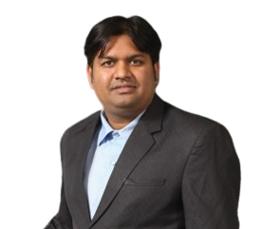
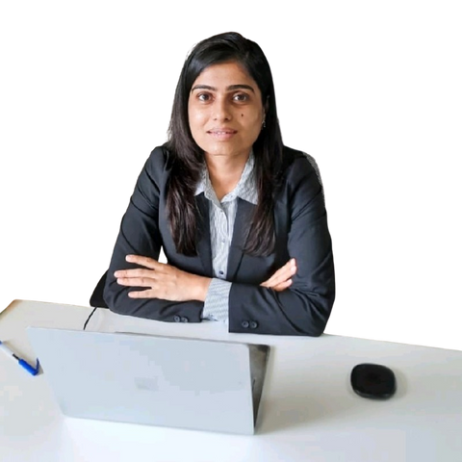
ADVISORS PRIVATE LIMITED
MEET OUR LEADERS
Neeta Valecha
Chandan Lahoti
Co-Founder & CEO
Co-Founder
Neeta qualified in the year 2004. She is also a Registered Valuer with more than 20+ years of Audit and Business valuation experience. She has been an All-India Merit Ranker (AIR) securing 27th AIR and 35th AIR in CA Inter and CA Final respectively.
Before getting into entrepreneurial venture in 2010, Neeta was in the Audit and Assurance group of Deloitte, Pune office where she was an active team member and Manager on audit engagement of companies engaged in diverse industries like Automotive, Information Technology, Heavy Engineering and Automotive Ancillaries.
She has interviewed more than 500 finance professionals before donningthehatofaCEOwithIAPL. Sheisfiercelypassionate about assisting people get their dream jobs at the same time supporting employers get skilled and quality hires in the agreed Turn Around Time (TAT). She mentors newly qualified Chartered Accountants and guides them in figuring out the next steps which could be daunting. She enjoys sharing her wisdom, insights and experiences with them.
CA Chandan is a Chartered Accountant and ex-EY. He was with EY for over 15 years in the Audit and Assurance department and was taking care of the recruitment vertical from the business side for quite a few years. He has interviewed over 1000 finance professionals during his career
Though Chandan has worked in Audit and assurance he has great domain knowledge in Direct and Indirect taxes as well. He is very active on various industry forums over and above AASB and WITC such as Maheswari Vidya Pracharak mandal, Maheshwari professional forum, Maheswari industrial group etc. He like mentoring fresh qualified CA and is mentor with various groups across India.
He has worked on Audit/ Assurance Engagement of large multinationals in India as well as overseas. As a part of EY he has led and managed Audit of Large Listed entities including the likes of Cummins India, Bharat Forge, Eaton etc.

Slide 4
OUR EXPERT RECRUITMENT TEAMS HELP COMPANIES FIND TOP-QUALITY CANDIDATES FOR OPEN FINANCE & ACCOUNTING JOBS IN INDIA.
BELOW ARE SOME OF THE AREAS WE HAVE EXPERTISE IN:
  Financial Accounting
  Financial Controller
  Financial Director / CFO
  Management Accountant
  CA Fresher
  Accountant/Bookkeeper
  Accounts Payable
  Accounts Receivable
  Payroll
  Shared Services
  Internal Control
  Merger & Acquisition
  Corporate Finance
  Forensic Accounting
  Insolvency and Restructuring Internal Audit
  Practice (Audit) and Assurance
  Direct & Indirect Tax
  Environmental Social Governance Services
Proactive sourcing
1
  Technical recruiting and shortlisting
2
  Pre-screening to ensure candidates meet the exact requirements
3
  Conducting interviews and summary notations
4
  On-boarding
5
  Induction
6
ADVISORS PRIVATE LIMITED

Slide 5








OUR SEARCH AND SELECTION PROCESS
In this digital age where CVs have filled up the internet, we understand the importance of pounding through the tons of CV till we find the right candidate for the Job. The work we do at Insight, is based on discipline and comprehensive approach which ensures our client find the right candidate who will meet all technical requirements.
OUR RECRUITMENT PROCESS
TO START WITH
We define our parameters: We first confirm your exact requirements for the candidate you are looking out for.
We make use of the following methods in sourcing the right candidate.
Influencers
Naukri
Sub Vendors (Current Big 6 senior people or Industry Senior people)
IIM
LinkedIn
CA Platforms
Our team leaders are a part of several communities and groups where they are socially active, we get lot of relevant resumes from them as well.
ADVISORS PRIVATE LIMITED

Slide 6







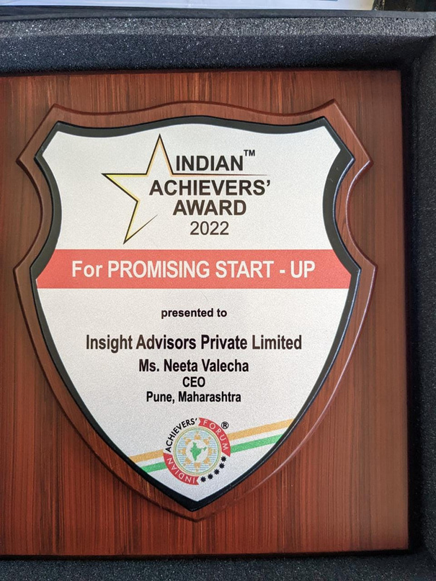
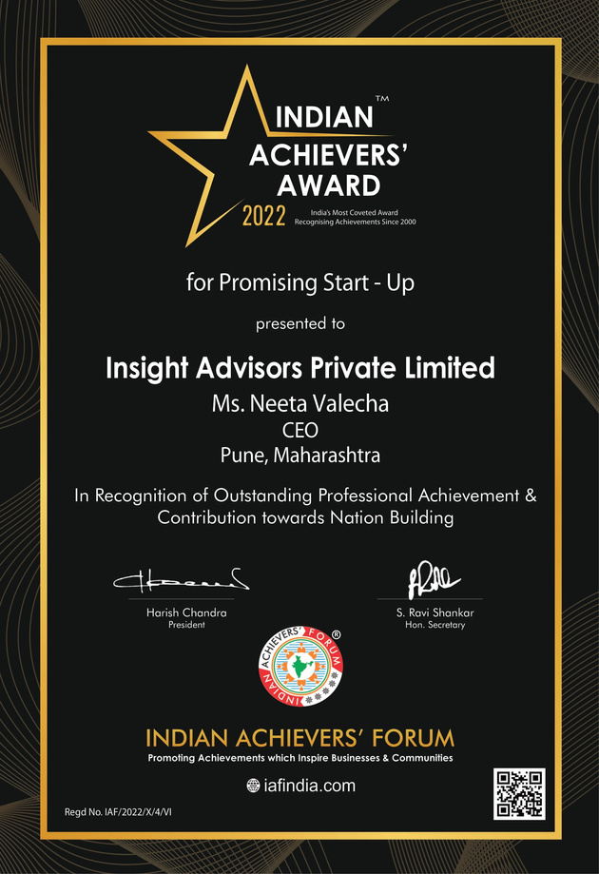





















SOME OF OUR CLIENTS
OUR ACHIVEMENTS
ADVISORS PRIVATE LIMITED

Slide 7
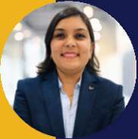



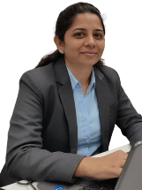


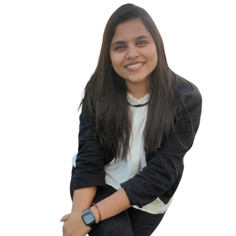

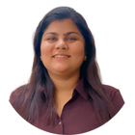

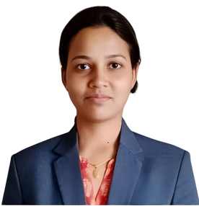
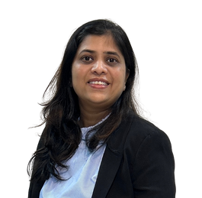
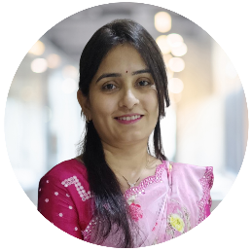
MEET THE TEAM LEADS
CA Twinkle Lahoti
CA Twinkle Lahoti
Twinkle Lahoti, a Chartered Accountant since 2012, understands client business requirements and sources appropriate candidates based on candidate aspirations.
+91 - 92092 25171 twinkle@insightadvisors.in
Sr. Team Lead
Apurva is an experienced professional with over 15 years of diverse experience in project management and human resources, including more than 5 years specializing in recruiting finance professionals. She excels at identifying and attracting top finance talent, leveraging her strong foundation in strategic planning and people management.
Apurva Kulkarni
Apurva Kulkarni
+91 - 75585 17183
apurva@insightadvisors.in
Sr. Team Lead
Pragati has done a Master’s degree in Human Resources & Marketing with more than 3 years of experience in Talent acquisition and her expertise is in end-to-end recruitment.
Pragati Bansal
Pragati Bansal
+91 - 79787 60025
pragati@insightadvisors.in
Team Lead
Lubna has a total of 5 yrs. of experience in Talent Acquisition (End-to-End Recruitment) and around 3 years of experience in Finance Recruitment. She has a diverse background in recruitment for the Domestic & International voice process. She has technical Recruitment for Engineers.
Lubna Kazi
Lubna Kazi
+91 - 80804 47188
lubna@insightadvisors.in
Team Lead
CA Swati Tibrewal
Chartered Accountant with 13 years of diverse experience in finance, audit and corporate strategy. Recently transitioned into finance professional recruitment, combining deep industry insight with a passion for connecting top talent with the right opportunities
CA Swati Tibrewal
Senior Talent Acquisition Specialist
+91 98904 56565
swati@insightadvisors.in
Shrushti is an MBA (Finance) and Semi-qualified Chartered Accountant and takes pride in her ability to connect the right people with the right opportunities, she is ensuring both organizational alignment and candidate satisfaction.
Shrushti Maheshwari
Shrushti Maheshwari
+91 94685 39351
shrushti@insightadvisors.in
Senior Talent
Acquisition Specialist

Slide 8

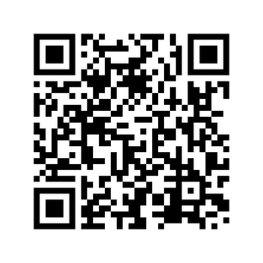
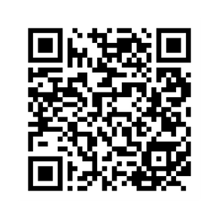
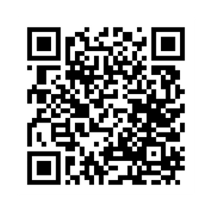
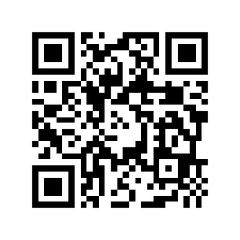




THANK YOU
You will no doubt appreciate that a firm profile of this nature is unlikely to contain every aspect of our approach, methodology and work plan. Whilst we have made sincere attempts, through this profile to communicate all the relevant matters, we will be pleased to have an opportunity to discuss with you to resolve any queries, which you may have.
ADVISORS PRIVATE LIMITED
Connect With Us :
Neeta Valecha
+91-95614 60836 neeta@insightadvisors.in
linkedin
Instagram
Website

